Slide 1
Welcome to the Strategic Planning Town Hall
Thursday, March 7, 12:15 – 2:00 Academic Building Lobby and Theatre

Slide 2
Highlights of Recent Accomplishments
New Degree Programs in Development: BS in Software Technology, BS in Cybersecurity, BS in HVAC, BS in Computer Science Education, AS in Biotechnology
Minors: 12 Academic minors developed with 300+ enrolled and 50+ graduates
External Funding: 21 Federal, State, City, and privately funded awards and 45 PSC CUNY awards. Federal awards totaled $4.78M
Student Centered Governance Accomplishments: Bereavement Policy, 5-year forgiveness policy, first-semester CR/NC policy; 4+1 bachelor’s/master’s MOU.
New Rad Tech Lab

Slide 3
What is Strategic Planning and why is it important?
City Tech’s 2024-2029 Strategic Plan will articulate our shared vision of priorities, goals and strategies for the next 5 years. It is more than identifying challenges, it is developing goals and realistic and sustained plans to achieve these goals.
Input from the college community, with a recognition of available resources, will help to develop an overall consensus on priorities and long-term strategies
Our Strategic Plan will be grounded in and aligned with the CUNY Lifting NY Roadmap, with a specific focus on our campus

Slide 4
Special Thanks to Strategic Planning Committee Members
Creating a student-centered, equity-driven college
LIB | Anne Leonard (chair)
ECFM | Michael Cannetti (secy)
HUM | Ines Corujo Martin
HUS | Smita Dewan
AFR | Dionne Bennett
Catalyzing upward mobility and prosperity
Dean, SoPS | Maureen Archer (chair)
BUS | Denise Sutton (secy )
ENG | Rory Richards
ENT | Sue Brandt
ETET | Li Geng
HUS | Ben Shepard
CST | Tamrah Cunningham
LIB | Cailean Cooney

Slide 5
Nurturing and renewing the academic core
ENG | Laura Westengard (chair)
CTTE | Euisuk Sung (secy)
Dean, SoAS | Justin Vazquez-Poritz
SOC | Sean MacDonald
Designing a convergent research and innovation ecosystem
BIO | Sanjoy Chakraborty (chair)
CET | Benito Mendoza (secy)
Assoc.Provost | Reginald Blake
CST | Marcos Pinto
MECH | Andy Zhang
RAD | Eric Lobel
RESD ENT | Laura Andreescu David Smith

Slide 6
Reimagining college finance and infrastructure
Dean, SoTD | Gerarda Shields (chair)
MAT | Katherine Poirier (secy)
BUS | Rachel Raskin
CST | Hong Li
VCT | Steven Indelicato
Promoting college differentiation and university integration
CMCE | Hamid Norouzi
HMGT | Lynda Dias
HMGT | Susan Phillip (secy)
MAT | Johann Thiel (chair)
PHYS | Boris Gelman

Slide 7
What is the CUNY Lifting New York Roadmap?
Six key thematic areas
Creating a student-centered, equity-driven university;
Catalyzing upward mobility and prosperity;
Nurturing and renewing the academic core;
Designing a convergent research and innovation ecosystem;
Reimagining University finance and infrastructure; and
Promoting college differentiation and university integration.

Slide 8
Goals 1: Be a National Leader in Providing Access to Higher Education for Diverse Populations of Students
Initiative #1.
Increase enrollment and retention at all levels by implementing a modern approach to admissions, financial aid, scheduling, and other programs and services that removes barriers for students.
Initiative #2.
Develop and implement a system-wide transfer experience that enables students to move seamlessly and successfully between and within CUNY campuses.
Initiative #3.
Accelerate infrastructure development and strategies needed to support and expand robust, high-quality content in traditional and online modalities across CUNY institutions and meet student needs for flexible courses and programs.
Initiative #4.
Increase the pipeline of students of color and other underrepresented groups entering graduate and professional programs to amplify equitable outcomes.

Slide 9
Goal 2: Improve Our Ability to Exceed Predicted Student Outcomes and Eliminate Academic Equity Gaps With Innovative Curriculum and Support for Our World-class Staff and Faculty
Initiative #1.
Become a model for academic excellence and innovative pedagogy by employing data-informed best practices for diverse populations and adopting a proactive approach to curricular development.
Initiative #2.
Support all CUNY employees with world-class professional development and leadership training.
Initiative #3.
Prepare students for successful careers by creating intentional connections between the disciplines, workforce skills, and employment outcomes from the moment of enrollment and supporting life-long learning.
Initiative #4.
Strengthen a university-wide ethic of care that prioritizes the well-being of our students, faculty and staff, embraces diversity, and engenders a true sense of belonging.

Slide 10
Goal 3: Advance Our Community Through Comprehensive Research, Engagement and Services
Initiative #1.
Amplify the quantity and quality of engaged public impact research and scholarship leveraging CUNY’s distinctive scale, diversity, and location in New York City.
Initiative #2.
Establish CUNY as the go-to-choice for student recruitment by industry partners.
Initiative #3.
Develop stronger ties with alumni and friends of CUNY to amplify opportunities for engagement, new sources of financial support, and a culture of life-long learning.

Slide 11
Goal 4: Modernize the CUNY System
Initiative #1.
Become an automated, data-informed system that facilitates effective decision making, the optimal use of resources, and compliance with federal, state and local laws.
Initiative #2.
Explore new budget and operating models, optimizing flexibility and new sources of revenue.
Initiative #3.
Provide students, faculty, and staff with state-of-the-art environmentally sustainable and accessible facilities to support innovation and learning.

Slide 12
President Russell K. Hotzler

Slide 13
Vice President Marling Sone
Enrollment Management and Student Affairs

Slide 14
Overview Enrollment Management & Student Affairs (EMSA)
I. Strategic Enrollment Management
• FAFSA Delays
• Admissions Applications Increase
• Accelerated Registration Calendar
• Enrollment and MCF Alignment
• Fall Enrollment Comparison
II. Student Affairs Initiatives Supporting Students’ Persistence and Graduation
• Student Wellness Relocation
• Food Pantry
• CUNY Reconnect
• Student Success Center
III. Strengthening EMSA with New Hires

Slide 15
Admissions Applications Increase

Slide 16
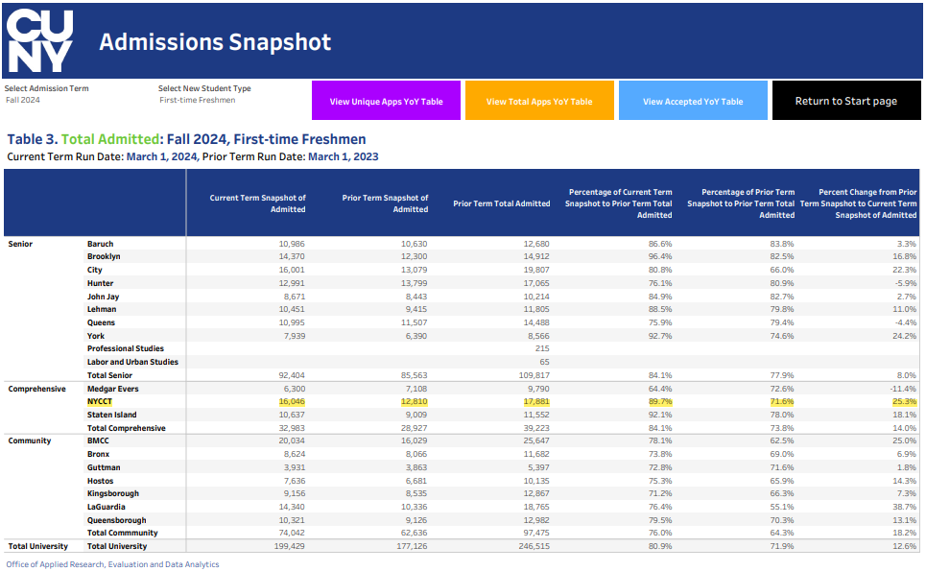

Slide 17
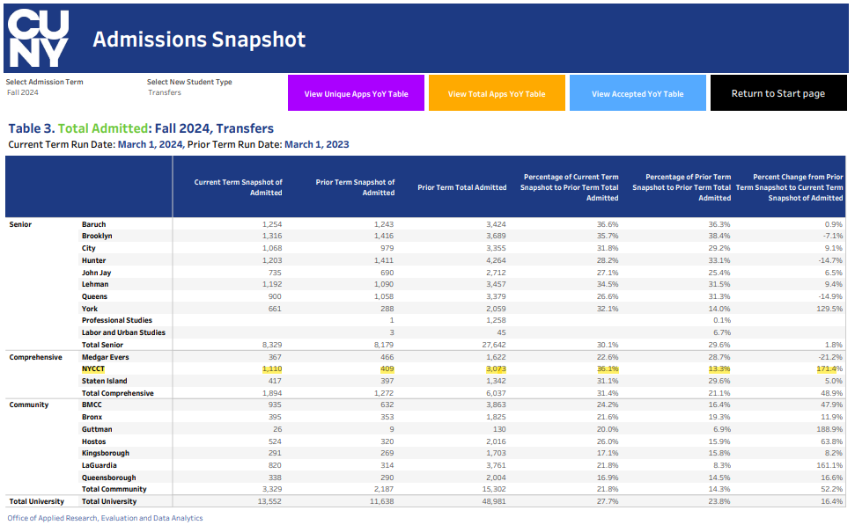

Slide 18
Accelerated Registration Calendar
Event | Date
Application for Direct Admissions/ On-the-Spot-Admissions | 3/4/2024
Finalize Fall 2024 MCF | 3/6/2024
Application for Non-Degree and Readmits | 3/18/2024
Registration for Special Programs | 3/21/2024
Registration for Summer 2024 | 3/21/2024
New Student Registration Day | 3/23/2024
Registration for general population for Fall 2024 | 3/25/2024
New Student Registration Day | 4/13/2024
Open House | 5/11/2024
New Student Registration Day | 5/22/2024
CUNY Commitment Day | 6/1/2024
New Student Registration Day | 6/8/2024
New Student Registration Day | 6/12/2024
New Student Orientation | 8/13/2024
New Student Orientation | 8/14/2024
New Student Orientation | 8/15/2024
New Student Registration Day | 8/17/2024
New Student Registration Day | 8/24/2024
Late registration | 8/27/2024
Late Registration Ends | 9/3/2024

Slide 19
Fall Enrollment Comparison

Slide 20
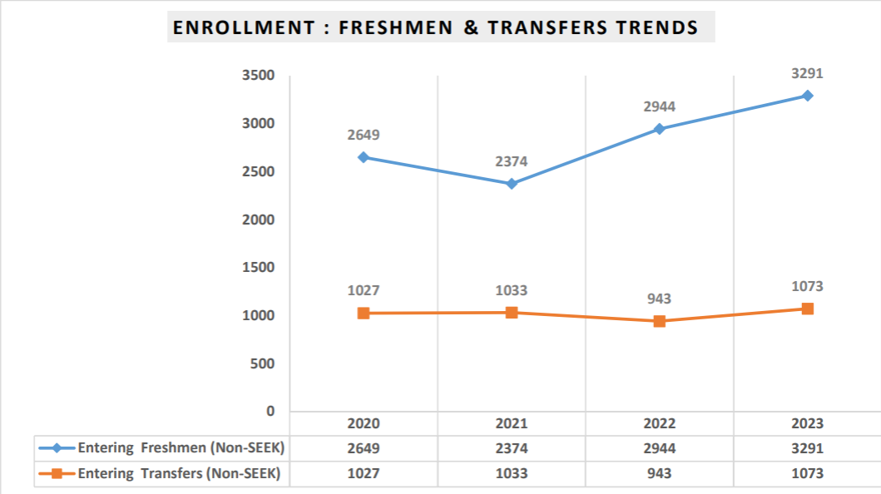

Slide 21
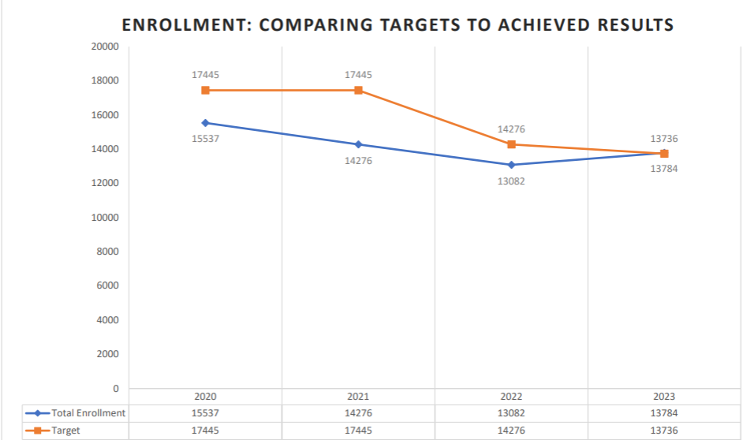

Slide 22
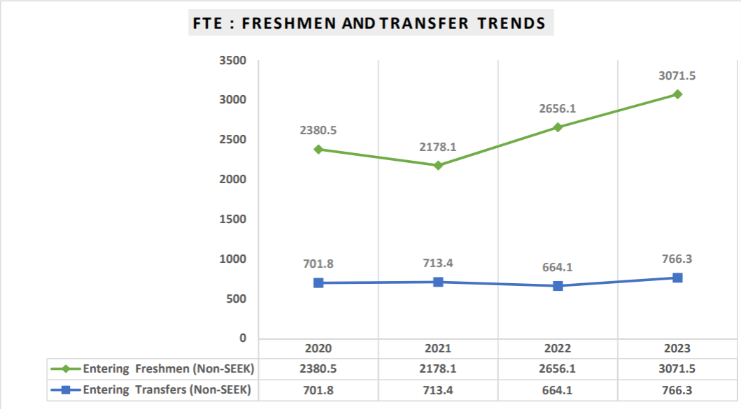

Slide 23
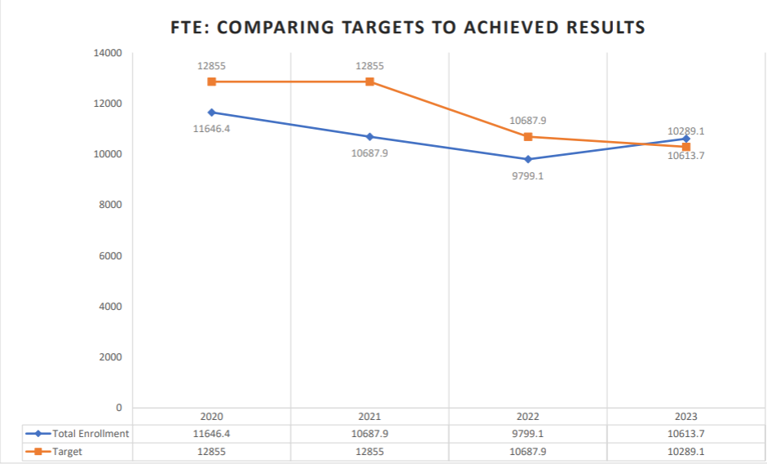

Slide 24
Division of Enrollment Management and Student Affairs New Hires
Employee Name | Job Title
Abeer Shariff | Onboarding Advisor- S.T.A.R
Alexandra Baez | Crisis Counselor- Counseling Center
Ana Trejo-Richardson | Associate director of Financial Aid
Angela Burns | Manager of Student Advocacy Accountability
Cody Tchou | Veteran Support Services Coordinator
David Dones | Program Coordinator- Student Success Center
Derwent Dawkins | Enrollment Registrar Director
Elizabeth Leone | Interim Education Director- Our Children’s Center
Gerson Ramirez | Student Life and Development Coordinator
Jennifer Cruz | Counselor & Clinical Case Manager- Counseling Center
Miguel Rodriguez | IT Academic Technology Coordinator- SEEK
Nicholas Millet | Interim Academic Program Manager & Associate Director
Paola Garcia Sanchez | Enrollment Administrative Assistant
Quentin Holt | Crisis Counselor- Center for Student Accessibility
Tiara Johnson | Operations Coordinator- Student Success Center
Trichna Paris | Admissions Coordinator

Slide 25
Vice President Miguel Cairol
Administration and Finance

Slide 26
Questions

Slide 27
Catalyzing upward mobility and prosperity Dean Maureen Archer
How can we promote retention and graduation rates while maintaining high academic standards?

Slide 28
Creating a student-centered, equity-driven college Prof. Dionne Bennett
What are the best strategies and biggest obstacles you have encountered in your efforts to create an equity-driven college?

Slide 29
Nurturing and renewing the academic core Dean Justin Vazquez-Poritz
Dream big: What do you think the academic core at City Tech should look like in 5 years?

Slide 30
Designing a convergent research and innovation ecosystem Profs. Benito Mendoza and Sanjoy Chakraborty
How can City Tech empower scholars, innovators, and entrepreneurs through an enhanced research infrastructure?

Slide 31
Promoting college differentiation and university integration Profs. Hamid Norouzi
Within CUNY, City Tech is distinguished by its professional and technological programs. What opportunities do you see for strengthening our degree programs and what are the weaknesses and threats to our continued success? What are appropriate goals?

Slide 32
Reimagining college finance and infrastructure Dean Gerarda Shields
What enhancements, initiatives or improvements should the College seek to invest in for both the physical (on-prem) infrastructure as well as the virtual infrastructure?

Slide 33
Thank you for joining us today
An email with information on how to submit additional questions and comments, will be sent out shortly
Thank you to everyone who contributed to the Town Hall, including Catalin Zidaru and his team, Hope Reiser, Billie Coleman, Michael Khan, Kim Cardascia, Imelda Perez, the Strategic Planning working groups, everyone on stage, and most importantly, all of you

